Slide 1

Design Presentation:
Simulating the Spread of COVID-19
Jingyi Chen, Genevieve Lyons, Rebecca Youngerman, Huahua Zheng

Slide 2
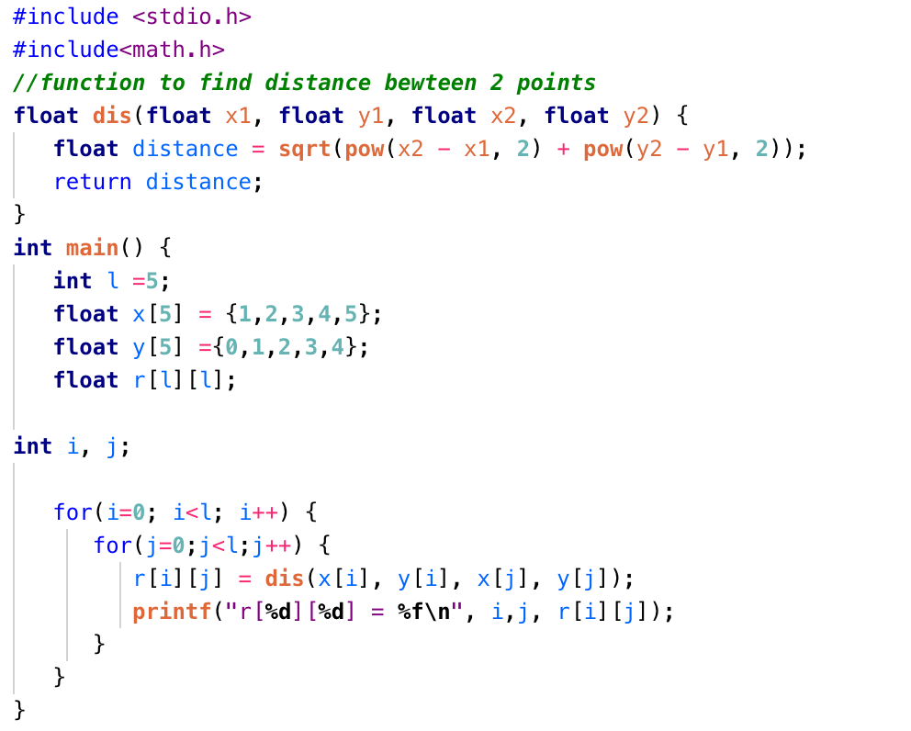
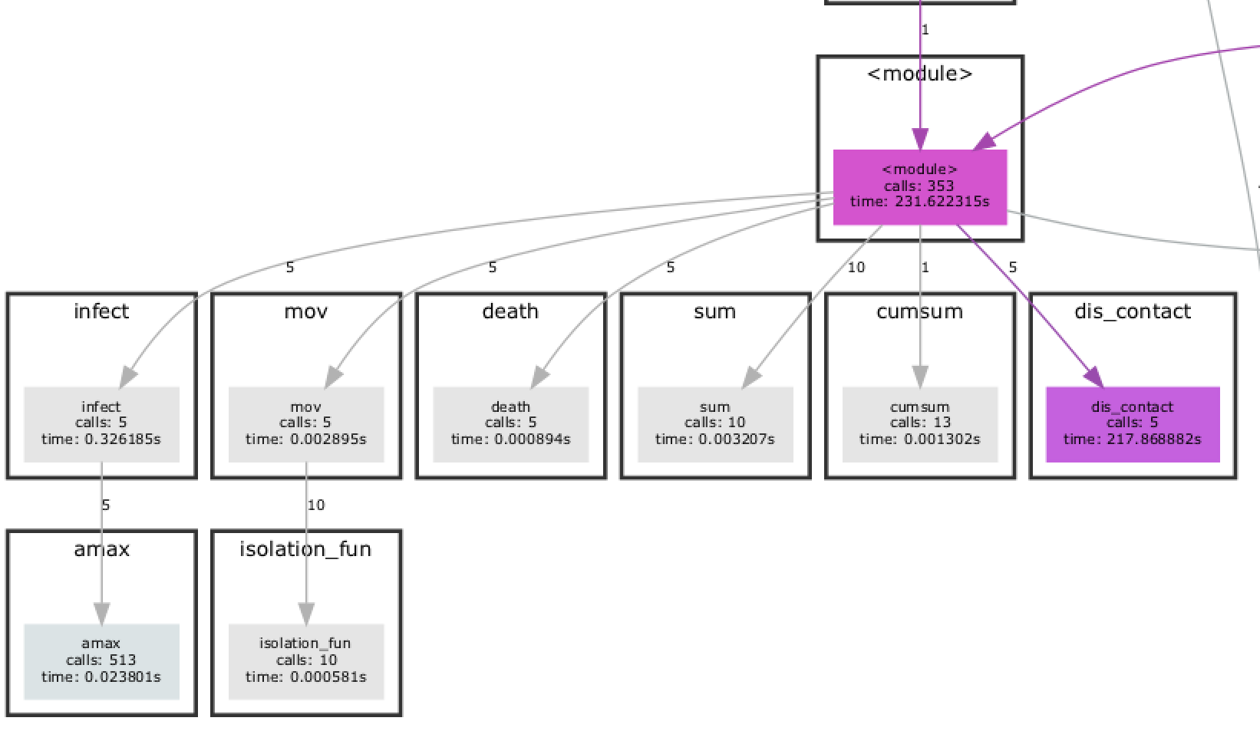
Analysis of Existing Code
Initial State
Distance
Simulation
At time t
Immune/Death
Infection
Moving
Notes:
pycallgraph graphviz Toy_Simulation_Infectious_Disease_Spread.py
python -m cProfile -o result.out -s cumulative Toy_Simulation_Infectious_Disease_Spread.py
python gprof2dot.py -f pstats result.out | dot -Tpng -o result.png

Slide 3
Parallelization Methods
01
Shared Memory
OpenMP (CPU)
02
Distributed Memory
MPI (many nodes)
03
Hybrid
MPI + OpenMP
04
Python/C Pipeline
Integrate parallelized C code with Python pipeline

Slide 4
Experiments
Strong Scaling:
Increased cores/threads/nodes on AWS
Isolation Functions: (also weak scaling):
Constant function
Random , constant movement (current prototype)
Social distancing
Dependent on time
exp(-0.1*t)
Sinusoidal distancing
(cos(2*t)+1)/2
Weak Scaling:
Varying by population density:
Rural: < 500 per square mile
Suburban: 500-4,000 per square mile
Urban:
Boston: 14,000/sq. mile
New York: 26,000/sq. mile

Slide 5
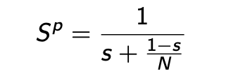
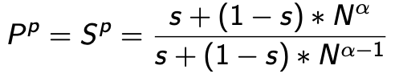
Complexity & Speedup
Time complexity: O(n²)
Serial model: 45 minute runtime/population density of 2,000
Theoretical speedup
Parallelizable fraction: s=92%
Strong scaling:
Weak scaling:
Overheads
Communication (MPI)
Load imbalance, synchronization (OpenMP)
I/O between Python and C
Optimizations
Loop scheduling
Remove redundant synchronization
Notes:
We would expect the pipeline to be slightly worse because of the serial part at the beginning and I/O between Python and C

